Slide 1
ITSP 2017

Slide 2
What exactly is ITSP?

Slide 3
The ‘Tech’ in ITSP
The difference between, for example, a truck engine and a Ferrari engine is in the technology applied in both
A chance for you to learn skills, and take your current know-how to the next level
Tech need not be all about Electronic circuits and coding. It’s everywhere

Slide 4
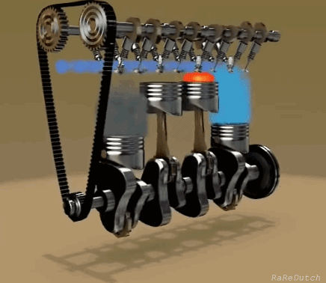

Slide 5
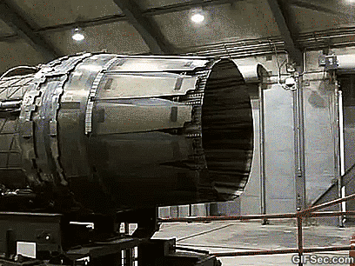

Slide 7
The Summer Project in ITSP
ITSP is: -
Not a research project
Not an internship
Not a course project

Slide 8
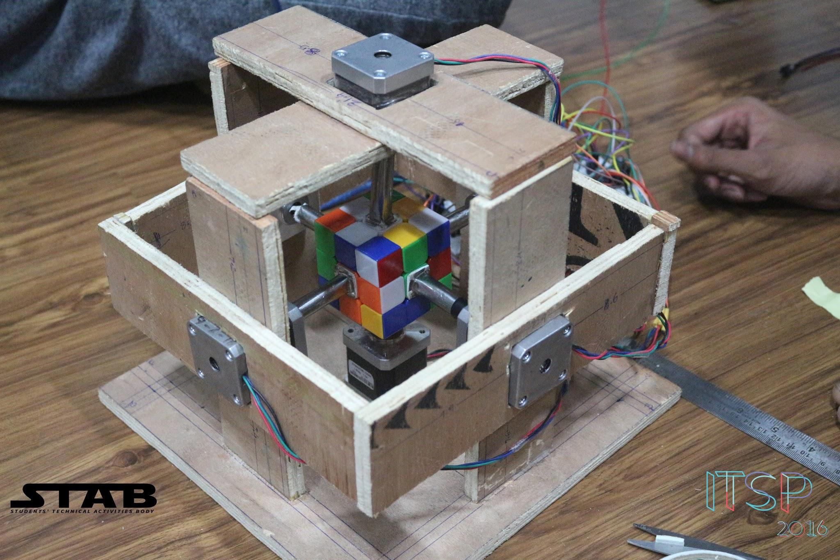

Slide 9
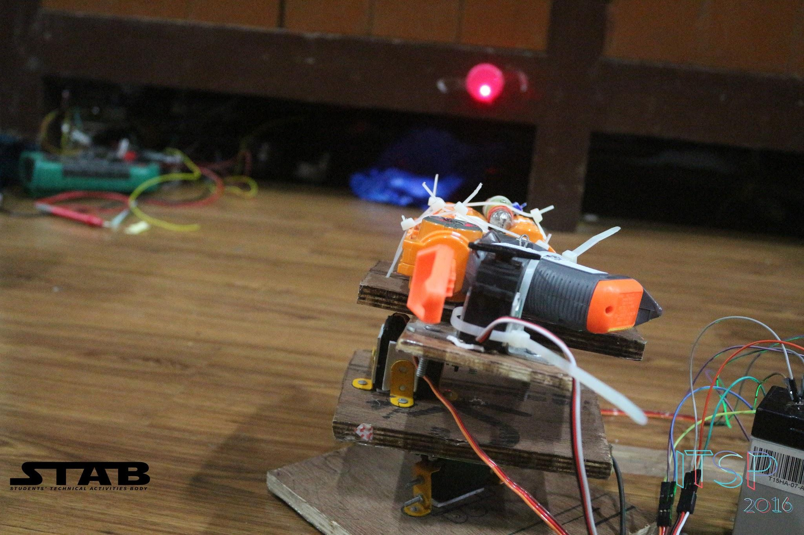

Slide 10
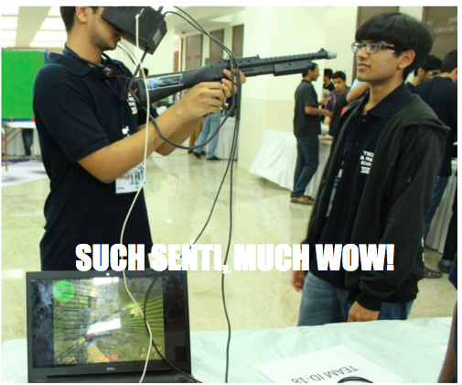

Slide 11
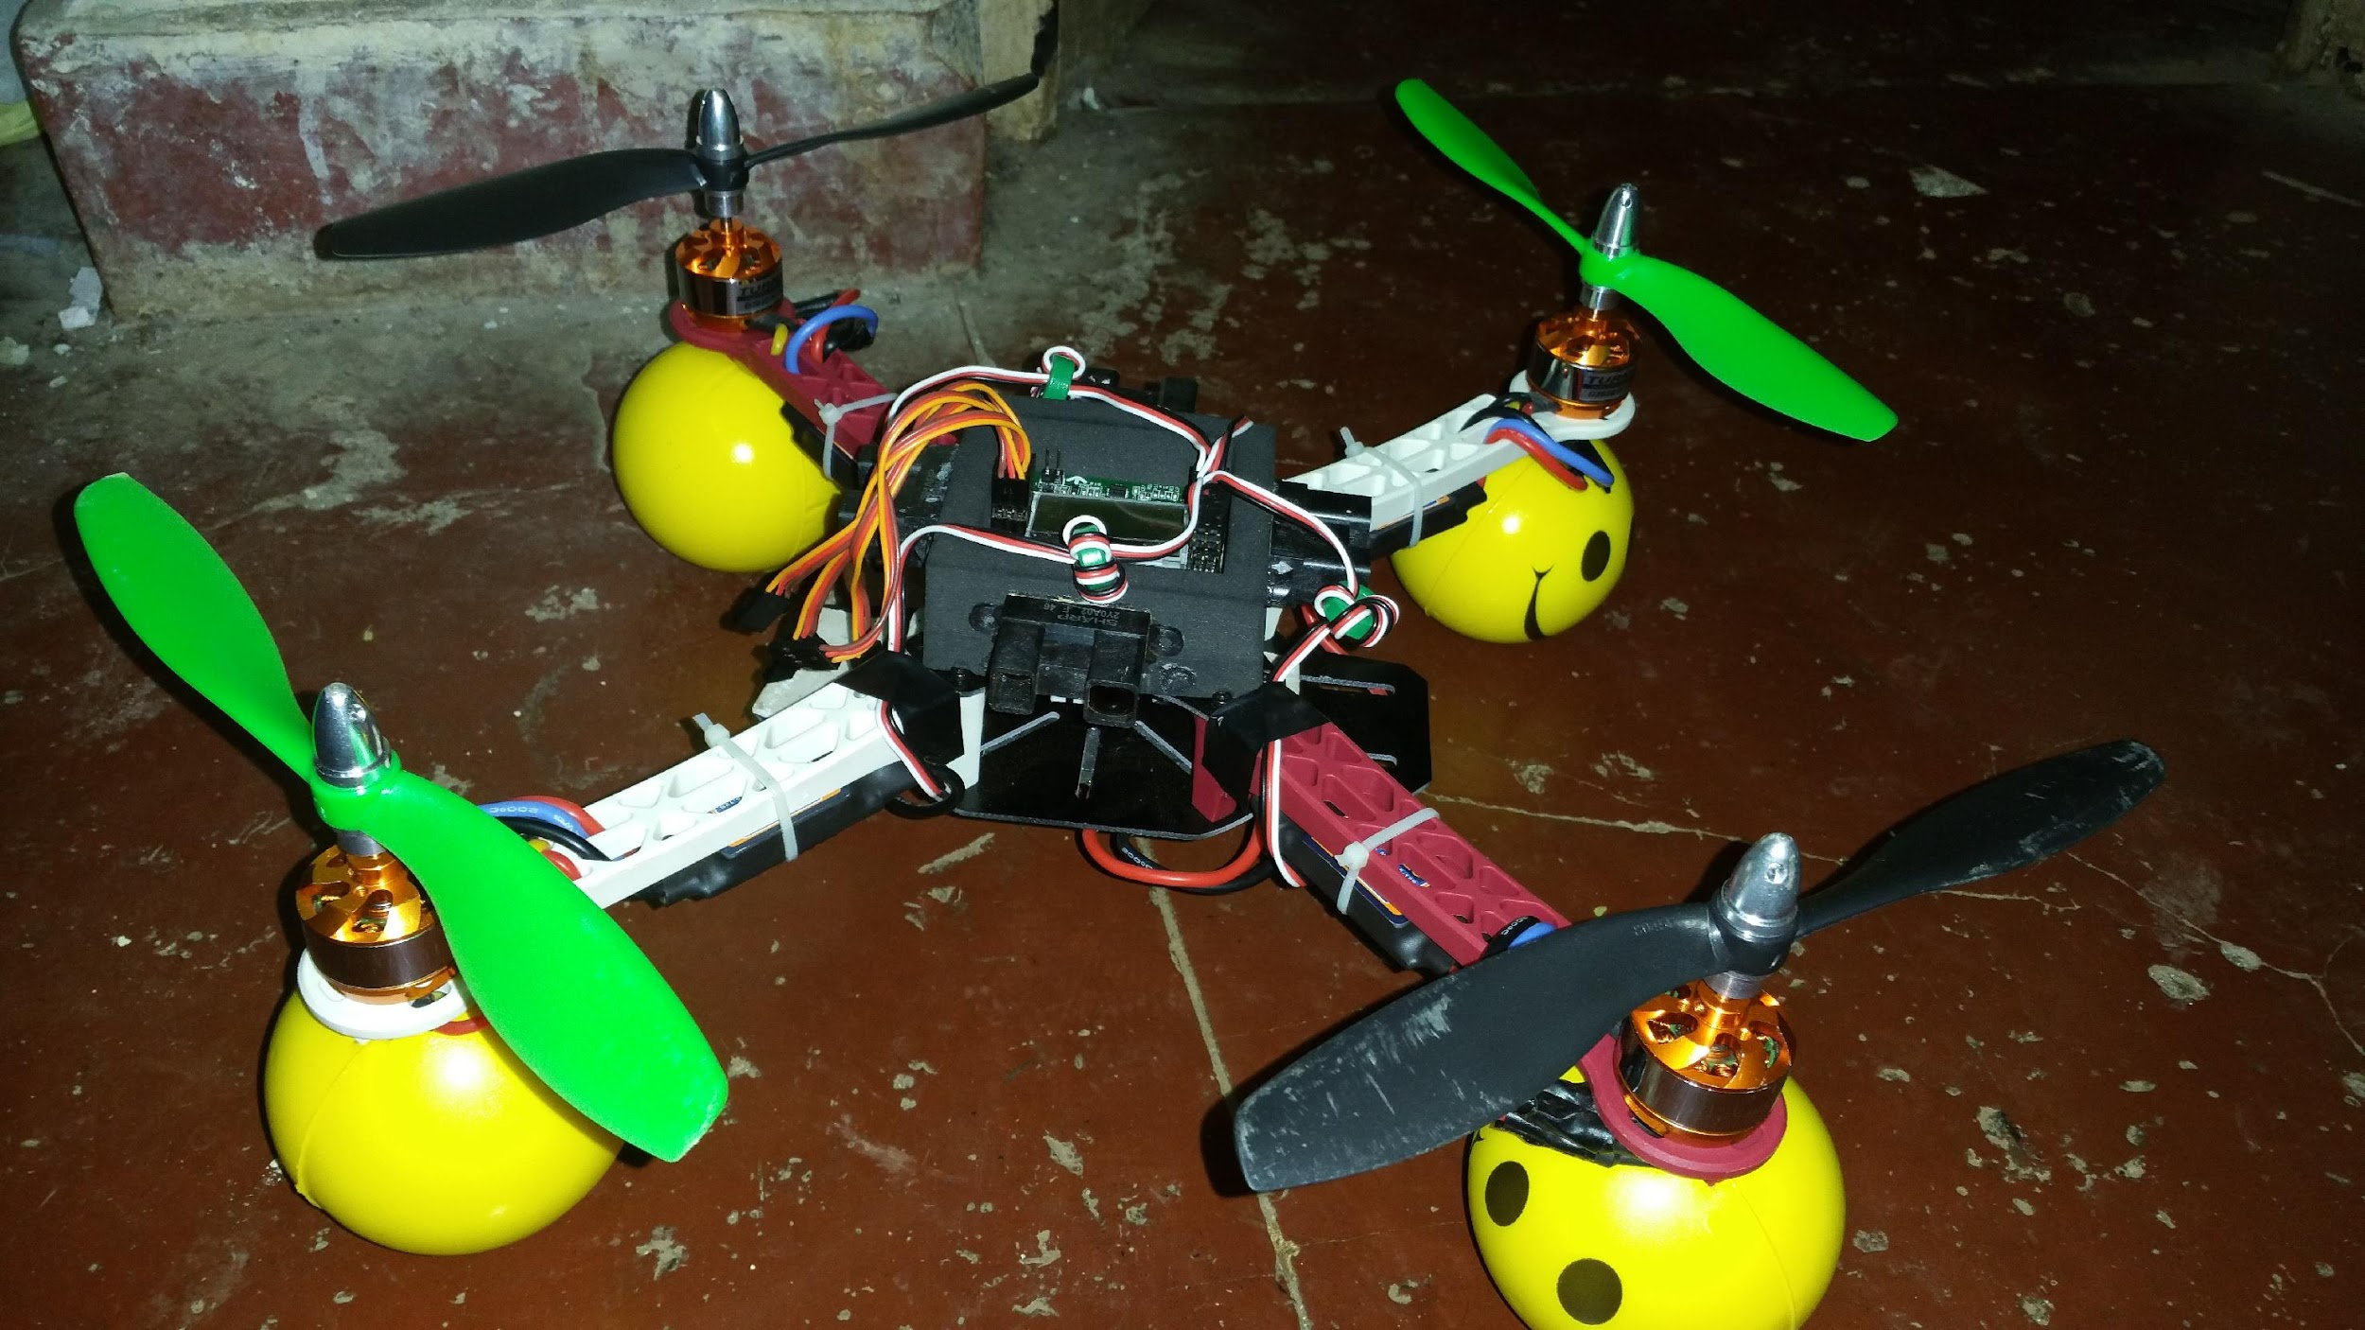

Slide 12
Who can do ITSP?

Slide 13
How to do an ITSP

Slide 14
How
Idea
Brainstorming - 26th March - H15 Mess
Abstract Submission - 1st April
Project review and finalisation
Mentors
ITSP begins on 6th May
40 days
Review meets every 10 days to keep you on track

Slide 15
The Institute in ITSP
Room Retention
Funding
RnD expo

Slide 16

Summer of Science
Maths and Physics Club, IIT Bombay
Reading projects under experienced senior mentors on a topic of your choice
Possible topics could include, but not limited to Quantum computation, Cosmology, Relativity, group theory, abstract algebra, etc.
Timeline - First week of May to second week of July.
Reports have to be submitted by the second week of July.
Certificates, with equal standing as those of ITSP, will be awarded on submission of the report.
Last year’s SoS reports have been put up at our club page! Do check them out here - http://mnp-club.github.io//projects/

Slide 17
Summer of Science
Maths and Physics Club, IIT Bombay
Reports will be put up in the club’s webpage.
Mentors will closely monitor the progress of their mentees - Books/references will be suggested along the way.
Can be done along with ITSP.
Interaction with your mentors will be online - neither mentor, nor mentee need to be present in the insti during the summer.
Last year’s SoS reports have been put up at our club page! Do check them out here - http://mnp-club.github.io//projects/
Contact
Thariq Shanavas
thariqshanavas@gmail.com
9847137527
Notes:
Mention that form will be floated soon.

